Slide 3
Notes:
1.Use content warnings if you’ll be discussing something potentially distressing or triggering
2.Be respectful of the experiences people of colour in the room are sharing
3.This session is designed for open discussion and reflection on racism and the positions we occupy within society in relation to it. Not a debating session but a chance for more transparency and discussion. If at any point you don't understand something or feel yourself not on the same page as everyone, ask.
4.POC having these discussions can feel vulnerable: freedom to leave for time out or get in touch after the workshop.

Slide 4
Notes:
Black and minority ethnic’, and is often used interchangeably with the term BAME, which stands for ‘Black, Asian and minority ethnic’.
‘Person of Colour’ is also often used.
What are your thoughts on the term?
BME is a term that can include people from a wide range of non-White backgrounds, such as African, Caribbean, Asian, Arab and Jewish
It is in itself contested whether this single term encompasses such diversity- could be seen as a form of ‘othering’ by using this lump term
There are different opinions towards these different terms, and some people may prefer to use a certain phrase when describing themselves and dislike other phrases.
For the purpose of this workshop we will be using BME, as it is generally the term under which initiatives and roles for non-White people are classified.
Beyond this workshop it is important to respect each individual’s attitude to how they identify, and not to assume that someone identifies as BME because of the way they look, or to take one individual’s experience and opinions and apply them to others you may meet.
At Cambridge we adopt a self-identifying system for BME initiatives in order to make the environment as inclusive as possible.

Slide 5
Notes:
Racism is prejudice and discrimination against a person or group of people based on their belonging to a particular racial or ethnic group that is a minority or marginalized
Includes scapegoating, stereotyping, bias and bigotry which can happen to anyone
But it’s not just about a person’s appearance, a key factor concerning racism is the difference in power between white and BME people and how this serves to benefit the former on systemic and individual level

Slide 6
Notes:
Systemic Racism refers to the policies and practices entrenched in structures of power
Institutional racism: originates in the operation of established and respected forces in the society. “Processes, attitudes, and behaviour that amount to prejudice” which are normalised within an organisation
Structural racism: refers to inequalities rooted in the macro-level, systems-wide operation of a society resulting in the marginalisation of designated groups on social, economic, and political levels
E.g. criminal justice system, education, employment, healthcare, politics

Slide 7
Notes:
98% of medical research and clinical studies are conducted on white patients (Harrison & Smart 2016)
Medical textbooks only teach students how illnesses present themselves in white patients and also perpetuate racist stereotypes e.g. that Black people have a higher pain tolerance than their white counterparts (many of these stereotypes originate in the racist pseudosciences of eugenics and phrenology)
Doctors are not fully equipped to treat BME patients (not prepared in recognising certain risk factors and/or signs of certain diseases in BME patients that do not present in the same way as white patients and/or are not as clinically obvious ) and their internalisation of damaging stereotypes can lead to harm

Slide 8
Notes:
For detailed stats and references, see the Open Letter to the Cambridge Medical School, on racism within healthcare: https://www.medschl.cam.ac.uk/wp-content/uploads/2020/06/Open-Letter-from-Medical-and-Non-Medical-Cambridge-Students.pdf
Black patients are 50% less likely to receive pain medication than white patients (Singhal et al., 2016)
Doctors give different treatment options to hypothetical white patients than they do to hypothetical black patients with the same symptoms (Boujie 2019, Zestcott 2016)
African and African-Caribbean people who have a psychotic illness and who live in London are between 4 and 8 times more likely to be detained than their white counterparts (Audini and Lelliott 2002, p. 225)
BAME patients are underrepresented in medical research studies and clinical trials (Harrison & Smart 2016) – in an extensive literature search to depict the differences in ethnicities, just 11 pieces of literature were found that focused on BAME patients, and 98% of research was conducted on Caucasians.

Slide 9
Notes:
It may be an uncomfortable thing to recognise - white people may not want to attribute their success partly to something they do not control but that benefits them.
Some people may use the argument that not all White people are successful to deny the existence of white privilege.
Being White isn’t an automatic free pass through life, but it means that the colour of your skin doesn’t disadvantage you in the same way it does for BME people

Slide 10
Notes:
Systemic racism influences individual behaviour on a day-to-day basis
Individual Racism refers to an individual's racist assumptions, beliefs or behaviours and is "a form of racial discrimination that stems from conscious and unconscious personal prejudice"
It is connected to/learned from broader socio-economic histories and processes and is supported and reinforced by systemic racism, both institutional and structural.
Reciprocal relationship

Slide 11
Notes:
Unconscious bias can play out as microaggressions

Slide 12
Notes:
What was racist about each?
What would you do if you saw this happen to a colleague? If any POC are willing to share how they tackle these microaggressions.
It suggests that the person does not belong in this environment, that because of what they look like they shouldn’t be able to speak ‘good English’
Implying someone does not belong to the category they choose to respond to the question ‘Where are you from?’ with due to their appearance
Promotes euro-centric beauty standards and implies this person’s race is not attractive
Treating the person like an object you can play with objectifies the group and suggests that their appearance can serve for White pleasure
What all of these cases share is a different standard being applied to people of colour, reflecting their disadvantaged position and status relative to white people in the structures of power that shape our experience in society.

Slide 14
Notes:
What do you think it is?
Appropriation
A “particular power dynamic in which members of a dominant culture take elements from a culture of people who have been systematically oppressed by that dominant group”.
The unacknowledged or inappropriate adoption of the customs, practices, ideas, etc. of one people or society by members of another and typically more dominant people or society for their own personal gain or interest
A common example is black people’s hair. It has, and is still, seen as weird, ugly, unprofessional, undesirable etc. but many celebrities copy typically black hair styles. They often call it a different name and do not acknowledge the culture it comes from. They then and receive huge amounts of praise and adoration for it.
Appreciation
Learning more about a particular culture to better understand their perspective.
Cultural exchange: this is where there is a mutual exchange and you acknowledge and give credit to the people of that culture
E.g. being invited to a traditional wedding and wearing traditional clothing specific to that culture. In this case it is not being worn for your own personal gain as you are wearing it in a respectful manner in appropriate setting.

Slide 16
Notes:
Only from people who actually came forward and reported

Slide 17
Notes:
[1] https://www.varsity.co.uk/news/17521: The bell, which was hung on the entrance to the college, was originally from the De Catharina slave plantation in Guyana, where it was used to control the work cycles of enslaved people. It was removed in 2019.
[2] https://www.varsity.co.uk/news/10882: The “Okukor,” a bronze statue of a cockerel, was stolen from Benin in 1897. It was eventually returned to its owners.
[3] https://www.theguardian.com/education/2020/jun/27/cambridge-gonville-caius-college-eugenicist-window-ronald-fisher: After student pressure, Gonville & Caius college removed a window commemorating Ronald Fisher, who founded the Eugenics Society and was a pioneer in the white supremacist ‘science’ of eugenics.
[4] https://www.varsity.co.uk/news/19233: In 2019, Cambridge University launched an enquiry to investigate the University’s historical links to the slave trade. Many colleges have also announced their own separate enquiries.
[5] https://www.varsity.co.uk/news/15971: As Prime Minister of South Africa, Jan Smuts introduced segregationist legislation which laid the foundations for apartheid. A portrait and bust of Smuts was prominently displayed in Christ’s, his alma mater.

Slide 18
Notes:
Not only should non-black students be aware of how they can be effective allies to the Black community, they should actively make sure their actions and words are not also further contributing to an existing culture of anti-blackness.
Limits of BME label and how this sometimes masks black struggles
The tendency of diversity quotas to ignore this group, yet still claim to be racially diverse
The specific tropes and stereotypes used to describe and present this group in the media/ society
All ethnic minorities experience racial discrimination differently, despite being rooted in the same prejudice

Slide 19
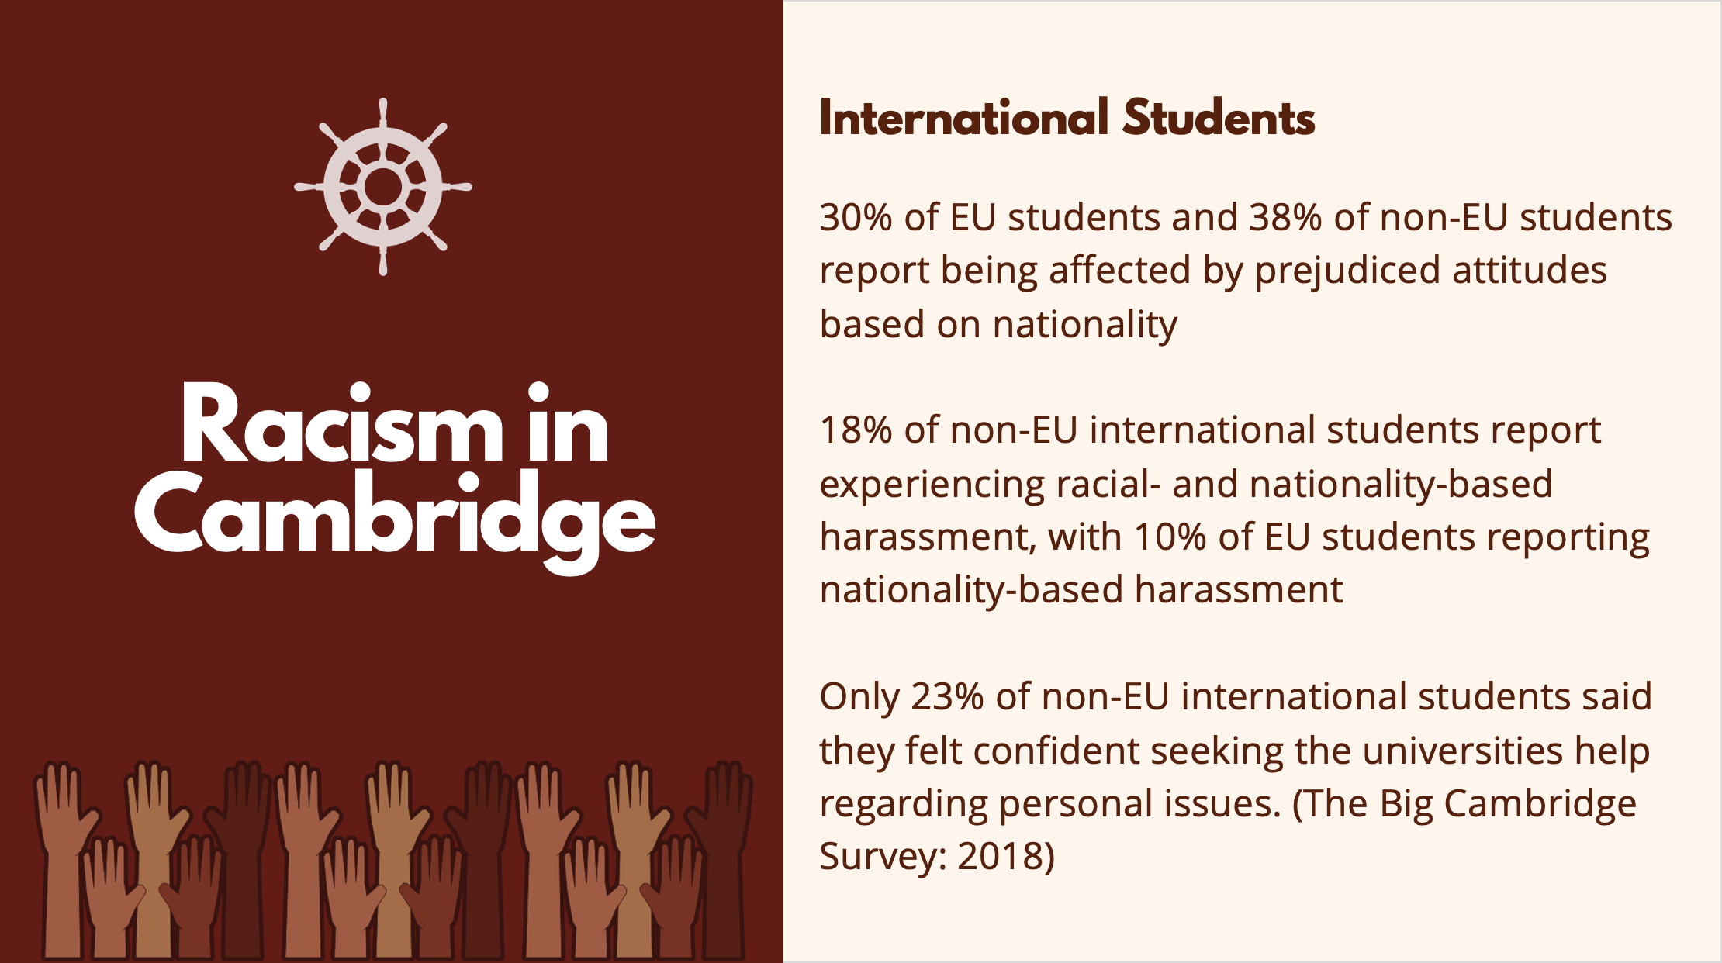
Notes:
How would your Cambridge ‘student experience’ be different if you were an international student who was ‘othered’ as soon as you arrived at university
Think about the effects of the international label and how damaging it may be, due to the way these individuals are spoken of/ about
Understand that the discrimination faced by the diaspora will inevitably be different than that international students face
Be aware of the fact these students may never have been a racial minority in the country they live in and how different that is in the UK

Slide 20
Notes:
This project was led by the sociology dept
Respondents were afraid of seeming over-sensitive or aggressive when reporting incidents
They felt powerless due to consequences of reporting- status hierarchy between the person reporting and perpetrator and how this would affect their progression through their degree.

Slide 21
Notes:
Committing to fighting racial inequality, not just showing sympathy.
Understand how to be a meaningful, non-performative ally.
Do not centre the narrative around yourself - stand in real solidarity, be prepared to do the work, keep supporting after the outrage/attention has died down.
Be proactively anti-racist.

Slide 22
Notes:
Don’t ignore these behaviours just because they are unintentional, these are often the harder forms of racism to spot.
Reflect on your own behaviour regardless of whether you consider yourself anti-racist, BME people included
People may not be aware of the biases that fuel what they’re saying, and so they must be prepared to learn and re-evaluate their judgement on what is and is not appropriate.
Ask yourself if what you are saying is based only on someone’s race or appearance.
Would you ask the same question/say the same thing to a White person?
NB this approach isn’t just restricted to racism

Slide 23
Notes:
Ensure that you listen to the person calling you out in order to understand the situation from their perspective rather than being defensive
Apologise for you action. By apologising for how the individual felt, you are being dismissive and invalidating the person.
By apologising and taking responsibility for your behaviour you are one step further to eradicating your own subconscious biases and overcoming any ignorance - use this as a chance to completely alter this behaviour
Focus on the impact of your actions rather than your original intentions.
We all have unknown biases that stem from ignorance which could manifest itself into subconscious racism and prejudice such as micro aggressions. Unlearning this is a conscious work in progress that does take time and effort, and being called out is an inevitable step in this learning process. Recognise that if you are called out, you are in a position of privilege and should not invalidate the concerns and reactions of your peers. Do not be afraid to admit when you mess up!
Reporting incidents: the first platform is anonymous so the University can’t take action or impose sanctions. The second can leads to a formal student disciplinary procedure.

Slide 24
